Slide 1
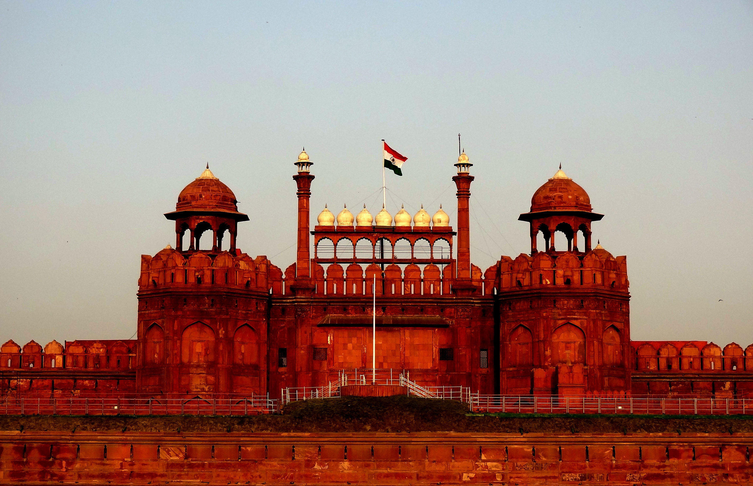



4th IEEE International Conference
on
Technology, Engineering, Management for Societal impact using Marketing, Entrepreneurship, and Talent
(TEMSMET 2025)
Conference Record Number: 65536
08th to 10th October 2025, Host by: NIT Delhi & IEEE TEMS
PAPER ID:
TITLE :
AUTHORS :
www.temsmet2025.org

Slide 2
2025 IEEE 4th International Conference on Technology, Engineering, Management for Societal impact using Marketing, Entrepreneurship and Talent (TEMSMET) Conference Record No: - #65536, NIT Delhi. www.temsmet2025.org

Slide 3
2025 IEEE 4th International Conference on Technology, Engineering, Management for Societal impact using Marketing, Entrepreneurship and Talent (TEMSMET) Conference Record No: - #65536, NIT Delhi. www.temsmet2025.org

Slide 4
Thank you
2025 IEEE 4th International Conference on Technology, Engineering, Management for Societal impact using Marketing, Entrepreneurship and Talent (TEMSMET) Conference Record No: - #65536, NIT Delhi. www.temsmet2025.org

